Slide 1


Technical Design Thinking II
Spring 2025
LabVIEW – Conditional & Repetition Flow
Dr. Bruce McFall

Slide 2
Important System Tasks
Color Sensors
Horizontal and vertical positioning
Calibration (all black and all white)
Set-up code for calibration procedure
Test materials for calibration procedure (Black and White cards)
Gyro Sensor
Position
Calibration based on device identifier (TBD)
Set-up code for calibration procedure
Motors (Actuators)
Test to compare output speed vs standard input control values
Set-up code for calibration procedure and equivalent speed output
Robot Motion Modes
Examine the motion of each of your possible modes
Pay special attention to the effects the modes will have on the sensors
Take into account all the tasks that will need to be performed
Think about durability over the whole project

Slide 3
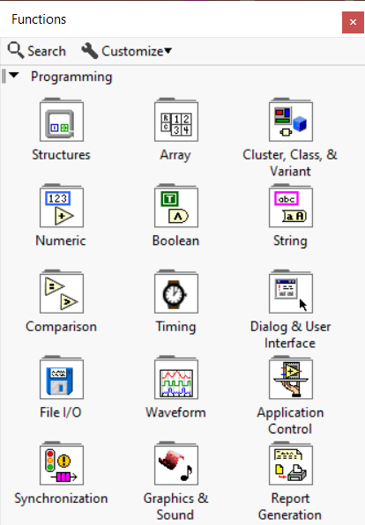
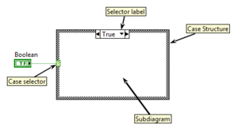
LabVIEW – Conditional Flow
Logical operators (Boolean and Relational) can be found in the Boolean and Comparison areas of the Functions Palette
The Case Structure can be found in the Structures area of the Functions Palette
The Select function can be found in the Comparison area of the Functions Palette

Slide 4
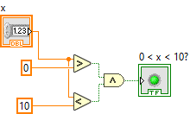


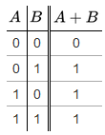

LabVIEW – Boolean Operators
For complex logical operations, you need to combine individual components with Boolean operators
Example: 0 < x <10
Translates into: 0 < x AND x < 10
AND
OR
NOT
Truth Tables
NAND
A and B
A or B
Not A
NOR

Slide 5
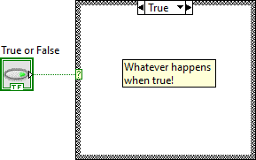
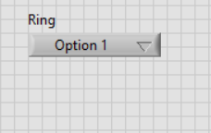
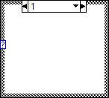
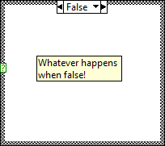
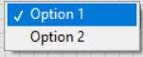
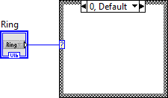
LabVIEW – Case Structure
Once you’ve created your condition, you can use it to control how information flows through your Block Diagram using two structures:
Case Structure
True/False (If-Else)
Numeric (Case Structure)
Change which case you see
Right click to add additional cases
Value = 0
Make sure one case
is default
Value = 1

Slide 6
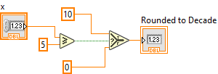
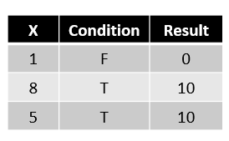
LabVIEW – Select Block
Once you’ve created your condition, you can use it to control how information flows through your Block Diagram using two structures:
Select Block
Allows you to select between two different flows

Slide 7
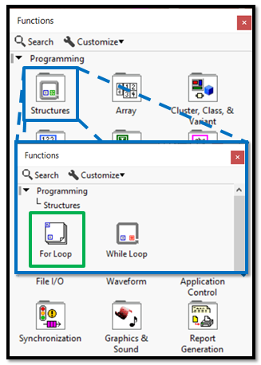
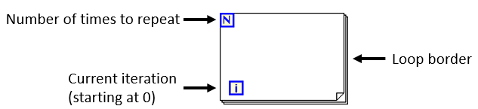
LabVIEW – Repetition
All repetition structures are available in the Structures area of the Functions palette
Two types of loops available in LabVIEW to implement the two different types of repetition flow
Counter-Based Flow: For Loop

Slide 8
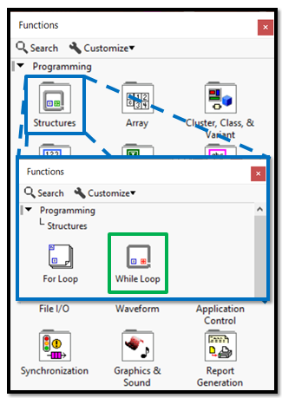
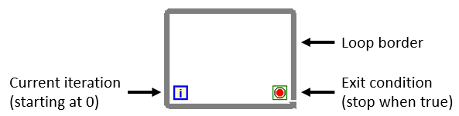
LabVIEW – While Loop
All repetition structures are available in the Structures area of the Functions palette
Two types of loops available in LabVIEW to implement the two different types of repetition flow
Conditional-Based Flow: While Loop

